Slide 1
هوش محاسباتی:
شبکه های عصبی مصنوعی
دانشكده مهندسي كامپيوتر
دانشگاه علم و صنعت ايران
mozayani@iust.ac.ir
مدل پرسپترون چند لایه

Slide 2
Solution to XOR problem
Minsky & Papert (1969) offered solution to XOR problem by
combining perceptron unit responses using a second layer of
units
1
3
2

Slide 3
XOR problem
In this graph of the XOR, input pairs giving output equal to 1 and -1 are depicted with green and red points.
These two classes cannot be separated using a line. We have to use two lines.
The following NN with two hidden nodes realizes this non-linear separation, where each hidden node is a perceptron and describes one of the two blue lines.
-1
This NN uses the sign activation function. The two green arrows indicate the directions of the weight vectors of the two hidden nodes, (1,-1) and (-1,1). They
indicate the regions where the network output will be 1. The output node is used to combine the outputs of the two hidden nodes.
0.1
+1
x₁
+1
-1
-1
x₂
+1
+1
-1

Slide 4


Types of decision regions
1
w0
Network
with a single
node
x1
w1
x2
w2
1
One-hidden layer network that
realizes the convex region: each
hidden node realizes one of the
lines bounding the convex region
L2
L1
1
Convex
region
1
x1
1
L3
L4
1
-3.5
x2
1
P1
P2
two-hidden layer network that
realizes the union of three convex
regions: each box represents a one
hidden layer network realizing
one convex region
1
1
x1
1
P3
x2
1
-0.5
1

Slide 5
Multi-layer perceptron
A four-layer network:
x₁
x₂
Input
Output
x_{n}
Hidden layer

Slide 6
MLP problem
Minsky and Papert (1969)
Discusses two-layer perceptrons with threshold logic units
“...our intuitive judgement [is] that the extension [to MLPs with hidden layers] is sterile.”
Drove wedge between numerics and symbolics researchers
Neural network funding dried up

Slide 7


Training: Backpropagation
Main problem:
the error for hidden neurons is not known !
1985 : Yann Le Cun
1985 : Parker
1986 : Rumelhart, Hinton & Williams
1988: Paul Verboss
David E. Rumelhart,
1942-2011

Slide 8
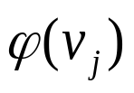
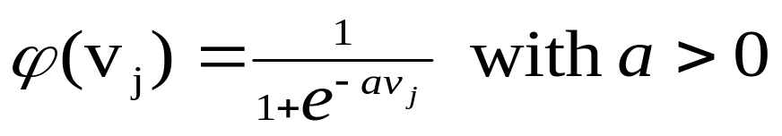
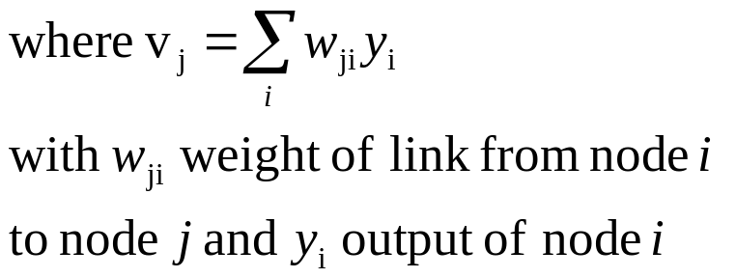

Training: Backpropagation
The classical learning algorithm of MLP is based on the gradient descent method.
For this reason the activation function are continuous functions of the weights, differentiable everywhere.
A typical activation function that can be viewed as a continuous approximation of the step (threshold) function is the Sigmoid Function. The activation function for node j is:
when a tends to infinity then ϕ becomes the step function
1
Increasing a
-10 -8 -6 -4 -2 2 4 6 8 10

Slide 9
Training: Backprop algorithm
The BP algorithm searches for weight values that minimize the total error of the network over the set of training set.
BP consists of the repeated application of the following two passes:
  Forward pass: in this step the network is activated on one example and the error of (each neuron of) the output layer is computed.
  Backward pass: in this step the network error is used for updating the weights (credit assignment problem). This process is more complex than the LMS algorithm for Adaline, because hidden nodes are linked to the error not directly but by means of the nodes of the next layer. Therefore, starting at the output layer, the error is propagated backwards through the network, layer by layer. This is done by recursively computing the local gradient of each neuron.

Slide 10
BP
Back-propagation training algorithm
BP adjusts the weights of the network in order to minimize the total mean squared error.
Network activation
Forward Step
Error propagation
Backward Step

Slide 11

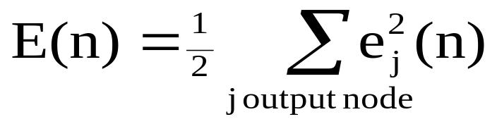
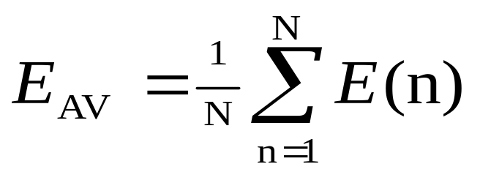
Total Mean Squared Error
The error of output neuron j after the activation of the network on the n^{th} training example (X_{(n)}, d_{(n)}) is:
The network error is the sum of the squared errors of the output neurons:
The total mean squared error is the average of the network errors of the training examples.

Slide 12
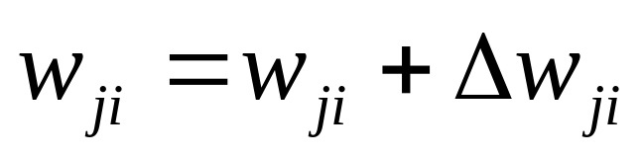
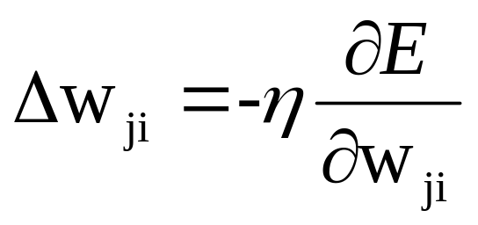
Weight Update Rule
The BP weight update rule is based on the gradient
descent method:
Take a step in the direction yielding the
maximum decrease of the network error E.
This direction is the opposite of the gradient of E.

Slide 13
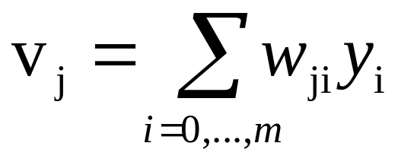
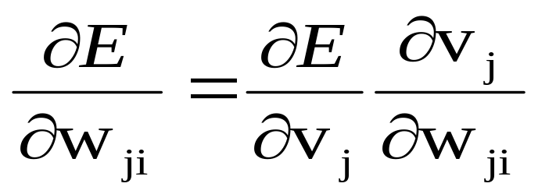
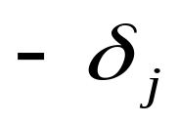
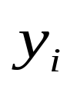
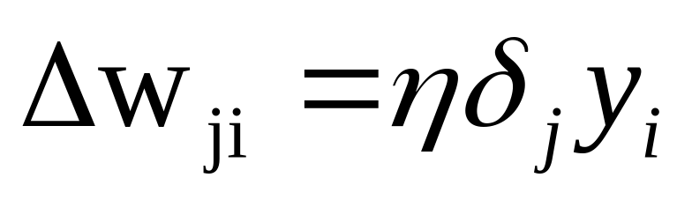
Weight Update Rule
Input of neuron j is:
Using the chain rule
we can write:
(local gradient of neuron j)
Therefore:

Slide 14
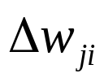

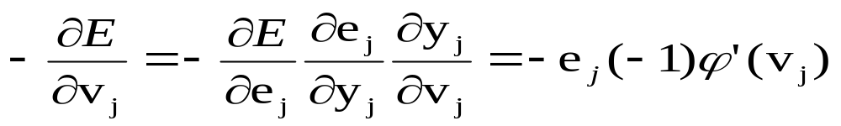


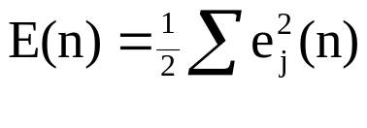
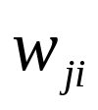
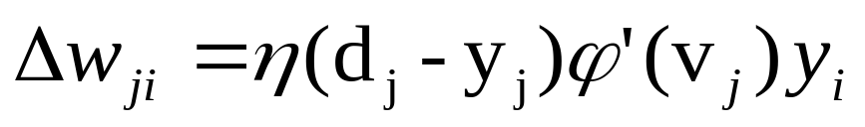
Weight update of output neuron
In order to compute the weight change we need to know the local
gradient of neuron j
There are two cases, depending whether j is an output or an hidden neuron.
If j is an output neuron then using the chain rule we obtain:
Knowing:
and
and
So if j is an output node then the weight from neuron i to neuron j is
updated of:

Slide 15

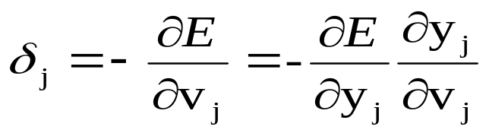
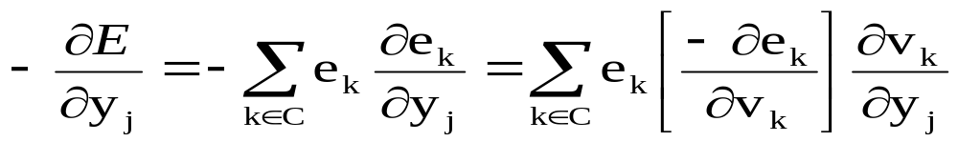
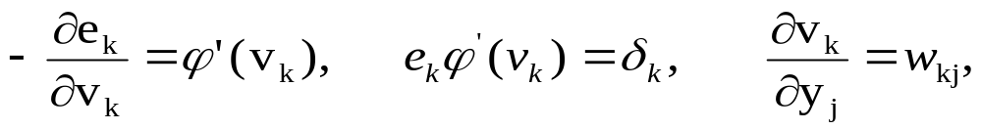
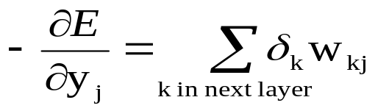
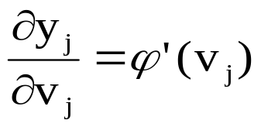
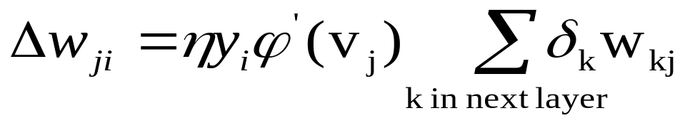
Weight update of hidden neuron
If j is a hidden neuron then its local gradient is computed using the local gradients of all the neurons of the next layer.
Using the chain rule we have:
Knowing:
Then
Moreover
So if j is a hidden node then the weight from neuron i to neuron j is
updated of:

Slide 16
Error backpropagation
The flow-graph below illustrates how errors are back-propagated to hidden neuron j
w_{1j}
e₁
δ₁
ϕ’(v₁)
δ_{j}
ϕ’(v_{j})
w_{kj}
e_{k}
ϕ’(v_{k})
δ_{k}
w_{m j}
e_{m}
δ_{m}
ϕ’(v_{m})

Slide 17
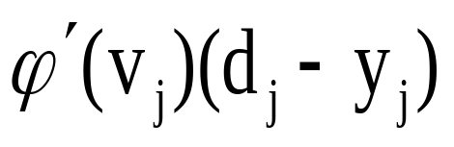
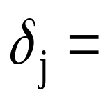
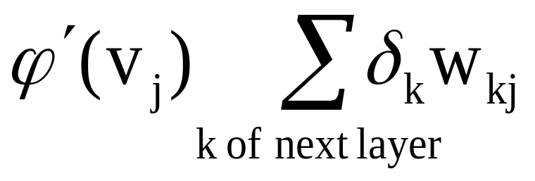
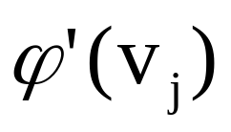
Summary: Delta Rule
Delta rule Δw_{ji} = ηδ_{j} y_{i}
IF j output node
IF j hidden node
Where is the derivative of activation function

Slide 18
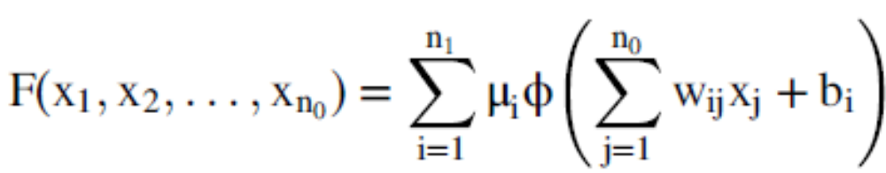
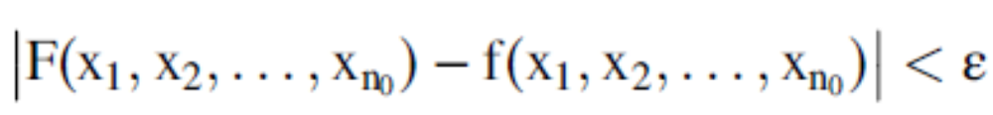
UNIVERSAL APPROXIMATION THEORY
Φ(.) a nonconstant, bounded, monotone-increasing continuous function
I_{n0} denote the n0-dimensional unit hypercube [0,1]^{n0}
given any function f ∈ C(I_{n0}) (space of continuous functions on I_{n0}) and ε>0, there exist an integer n1 and sets of real constants μ^{i} and b_{i}, and w_{ij}, where i=1;2;...;n1 and j=1;2;...;n0 such that we may define:
As an approximate realization of the function f(.); that is:

Slide 19
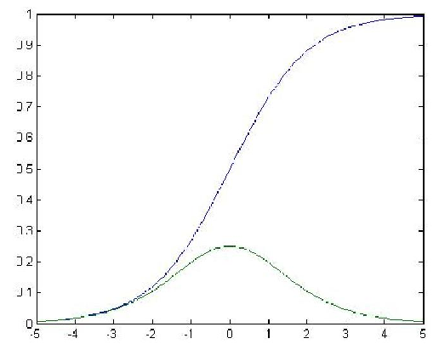
Logistic activation function and its derivative
Since the amount of change in a given weight is proportional to this derivative, weights will be changed most for those units that are near their midrange and, in some sense, not yet committed to being either on or off.

Slide 20
Weight decay
it sometimes happens that hidden units have strong learned input weights that ’pin’ their activation against 1 or 0, and in that case it becomes effectively impossible to propagate error back through these units.
Different solutions to this problem have been proposed:
One is to use a small amount of weight decay to prevent weights from growing too large.
Another is to add a small constant to the derivative of the activation function of the hidden unit.

Slide 21
η adaptation
If η is small then the algorithm learns the weights very slowly, while if η is large then the large changes of the weights may cause an unstable behavior with oscillations of the weight values.
A heuristics for accelerating the convergence of the back-prop algorithm through η adaptation:
  Heuristic 1: Every weight has its own η.
  Heuristic 2: Every η is allowed to vary from one iteration to the next.

Slide 22
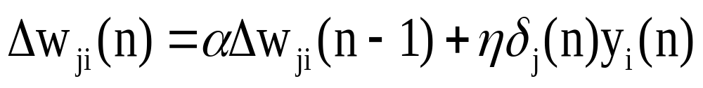

Generalized delta rule
A technique for tackling the problem of η is the introduction of a momentum term in the delta rule which takes into account previous updates. We obtain the following generalized Delta rule (Rumelhart method):
α is the momentum constant
the momentum accelerates the descent in steady downhill directions.
the momentum has a stabilizing effect in directions that oscillate in time.

Slide 23
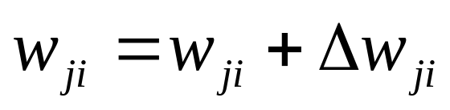
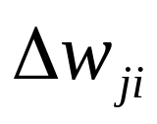
BP algorithm (incremental-mode)
n=1;
initialize w(n) randomly;
while (stopping criterion not satisfied and n<max_iterations)
  for each example (x,d)
  - run the network with input x and compute the output y
  - update the weights in backward order starting from those of the output layer:
  with computed using the (generalized) Delta rule
  end-for
n = n+1;
end-while;

Slide 24
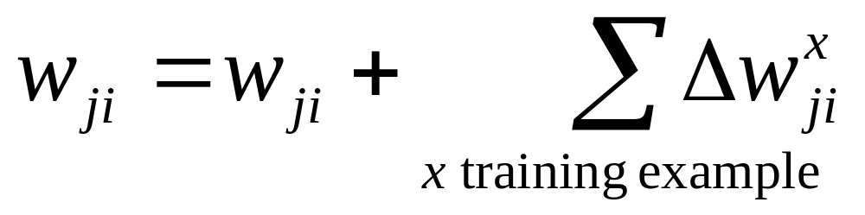
BP algorithm (Batch mode)
In the batch-mode the weights are updated only after all examples have been processed, using the formula
In the incremental mode from one epoch to the next choose a randomized ordering for selecting the examples in the training set in order to avoid poor performance.

Slide 25
Stopping criterions
Sensible stopping criterions:
  total mean squared error change: BP is considered to have converged when the absolute rate of change in the average squared error per epoch is sufficiently small (in the range [0.1, 0.01]).
  generalization based criterion: After each epoch the MLP is tested for generalization. If the generalization performance is adequate then stop. If this stopping criterion is used then the part of the training set used for testing the network generalization will not used for updating the weights.

Slide 26
MLP Network Design
Data representation
Network Topology
Network Parameters
Training
Validation

Slide 27
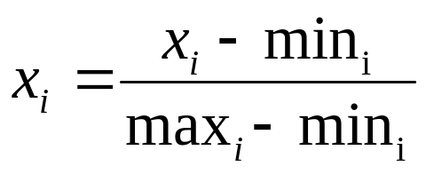
Data Representation
Data representation depends on the problem. In general MLPs work on continuous (real valued) inputs. So symbolic data are encoded into continuous ones.
Inputs of different types may have different ranges of values which affect the training process. Normalization may be used, like the following one which scales each inputs to assume values between 0 and 1.

Slide 28
Network Topology
The number of layers and of neurons depend on the application. In practice this issue is solved by trial and error.
Two types of adaptive algorithms can be used:
  Network Pruning: start from a large network and successively remove some neurons and links until network performance degrades.
  Network Growing: begin with a small network and introduce new neurons until performance is satisfactory.

Slide 29
Network parameters
How are the weights initialized?
How is the learning rate chosen?
How many hidden layers and how many neurons?
How many examples in the training set?

Slide 30
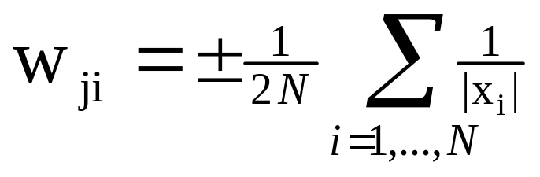
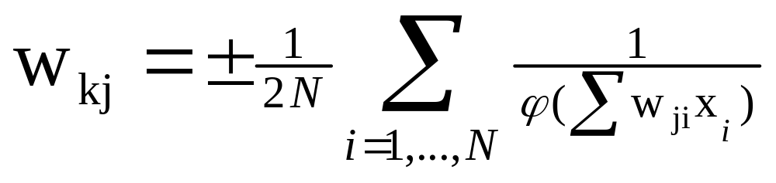
Initialization of weights
In general, initial weights are randomly chosen, with typical values between -1.0 and 1.0 or -0.5 and 0.5.
If some inputs are much larger than others, random initialization may bias the network to give much more importance to larger inputs. In such a case, weights can be initialized as follows:
  input (first) layer:
  Other layers:

Slide 31
learning rate
The right value of η depends on the application. Values between 0.1 and 0.9 have been used in many applications.
Other heuristics adapt η during the training as described in previous slides.

Slide 32
Adaptive learning rate
The learning rate parameter changes as the algorithm progresses
  Bold Driver Method
    modifies the learning rate based on change in E
      If E increases, then learning rate is reduced
      If E decreases, then learning rate is increased
  Self-adaptive
    Each weight has its own learning parameter
      increase, if the sign of δ doesn’t change
      decrease, if the sign of δ changes

Slide 33
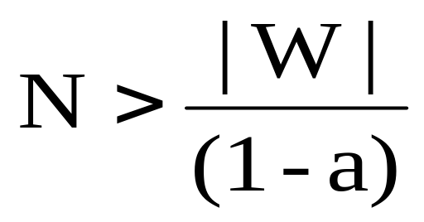
Training
Rule of thumb:
  the number of training examples should be at least five to ten times the number of weights of the network.
Other rule:
|W|= number of weights
a=expected accuracy on test set

Slide 34
Over-fitting
Over-fitting = tuning to fit the idiosyncrasies of the training examples that are not representative of the general data.
An ANN’s ability to learn its training data is proportional to the number of hidden neurons, but so is overfitting!

Slide 35
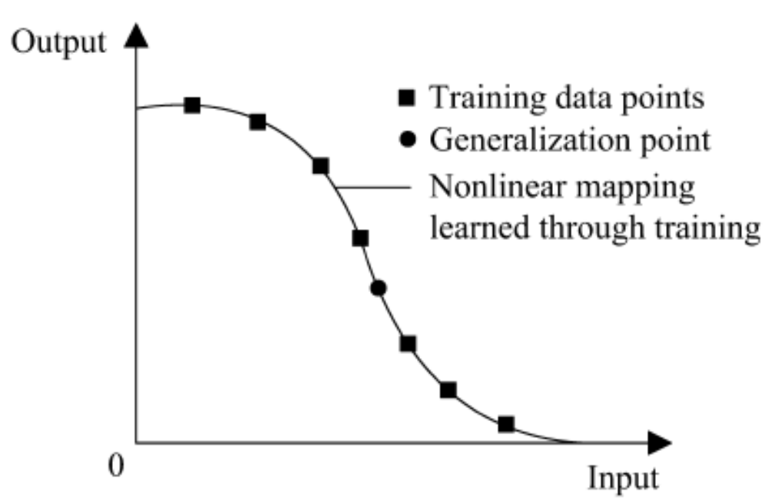
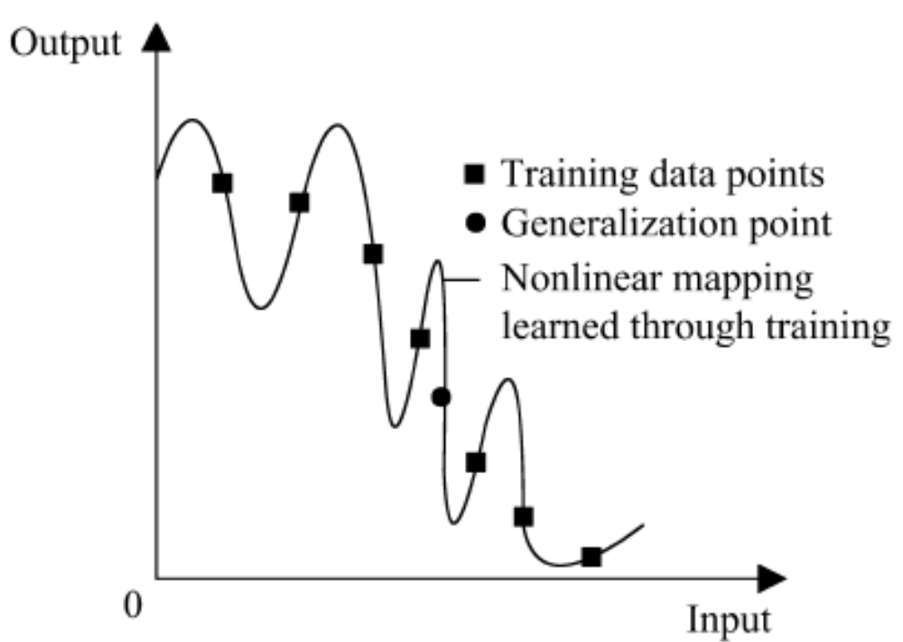
Over-fitting

Slide 36
Over-fitting
Remedies:
  Start with just a few neurons in the hidden layer
  Use a test set as well as a training set
  Decay weights by small fraction after each iteration
Keep the set of best weights so far (on the training set), and the current set of weights. Stop training when the test set error goes up a lot. Use the best weight set as the result.

Slide 37
Over-fitting
Over-fitting is a major problem when data sets are small. If small, then can split the total data into k different Distributions of training and test sets. Take the average over the k distributions.
OR split the m test examples into k parts, and average the test error values (using the k-1 parts as part of the training set).

Slide 38
Some remarks
Often, the more weights in the network, the easier to slip
out of a local minimum via another dimension (weight),
but local minima can cause difficulties (theory here is weak).
Can train multiple nets with the same data, by initializing with different small weights. Choose the network with the best test set performance. Or, take the average output over several networks (“committee” network members).

Slide 39
Applicability of MLP
Every boolean function can be represented by a network with a single hidden layer
but it might require exponential (in the number of inputs) hidden neurons.
Every bounded piece-wise continuous function can be approximated with arbitrarily small error by a network with one hidden layer.
Any continuous function can be approximated to arbitrary accuracy by a network with two hidden layers.

Slide 40
Applications of MLP
Classification
Function approximation
➔ Generalization

Slide 41
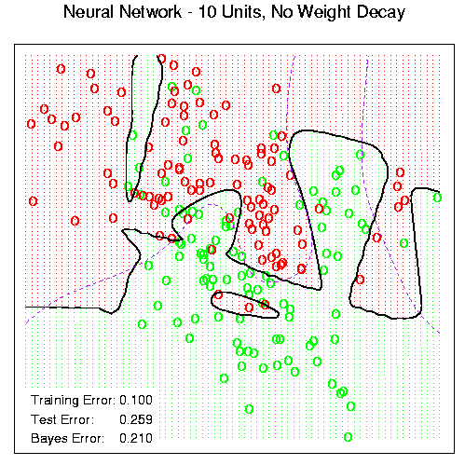
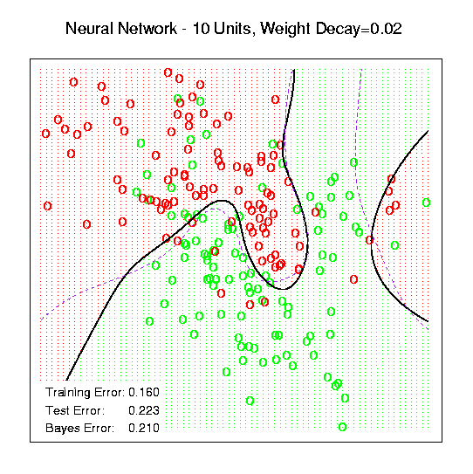
Example

Slide 42
Hidden layer interpretation
A hidden layer can give information about the nature of the input data, e.g. send in an 8 digit binary signal with 8 input neurons, where 7 are 0, one is 1, and the targets are the same as the inputs. Then the 3 neuron hidden layer outputs take (nearly) the binary code (001, 010, 011..) for the 8 possible inputs. Hidden layers can discover useful data representations!
More layers, more complex representations!

